Slide 1

Dyslexia awareness session

Slide 2
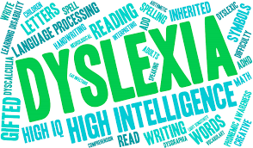
Dyslexia awareness
Notes:
Mention dyslexic tendencies of staff and not having to do the activities

Slide 3
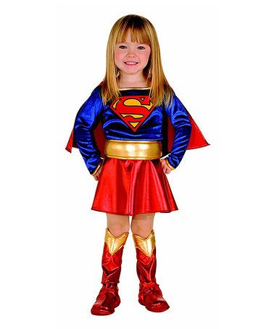
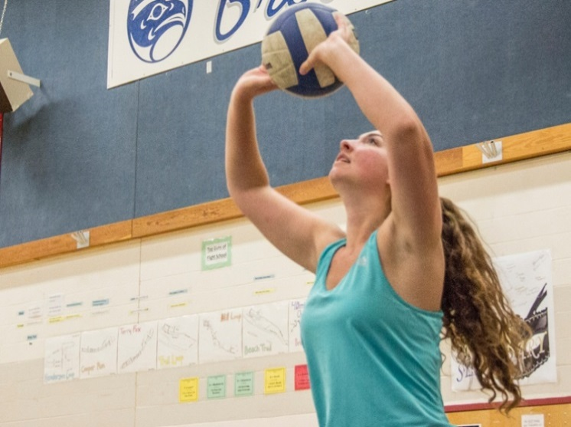
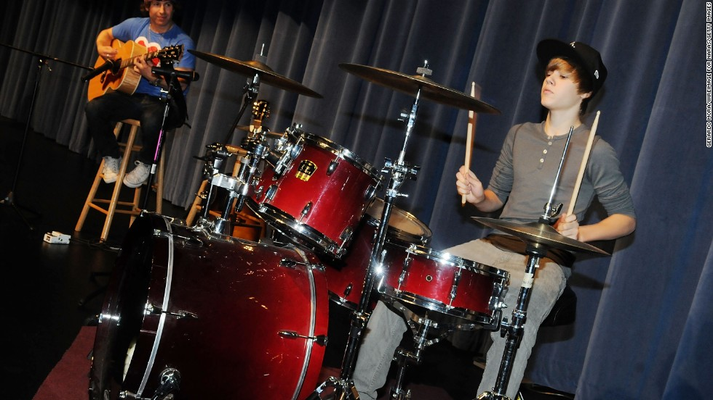

Think about your child. What are their strengths?

Slide 4
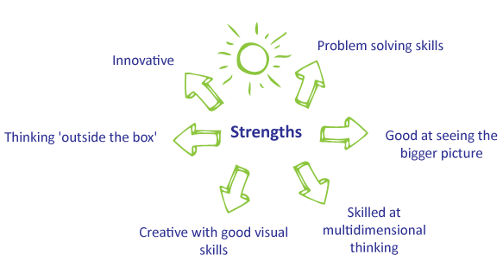


Strengths associated with dyslexia

Slide 5
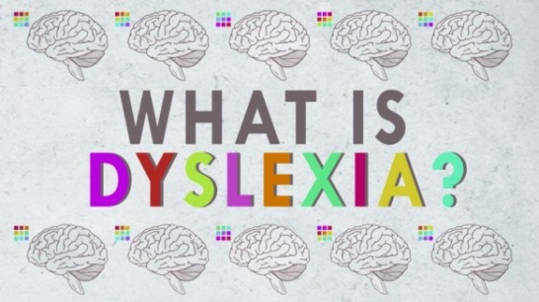
What is dyslexia?
Dyslexia is the most common SEN found in schools
Dyslexia is classed as a SpLD and affects the way information is learnt and processed
Challenges can include reading, writing and spelling. Some children also have difficulties with phonological awareness, memory and processing
About 4% of the population are severely dyslexic and 10% show some tendencies
Dyslexia is not an obvious difficulty; it can be hidden

Slide 6
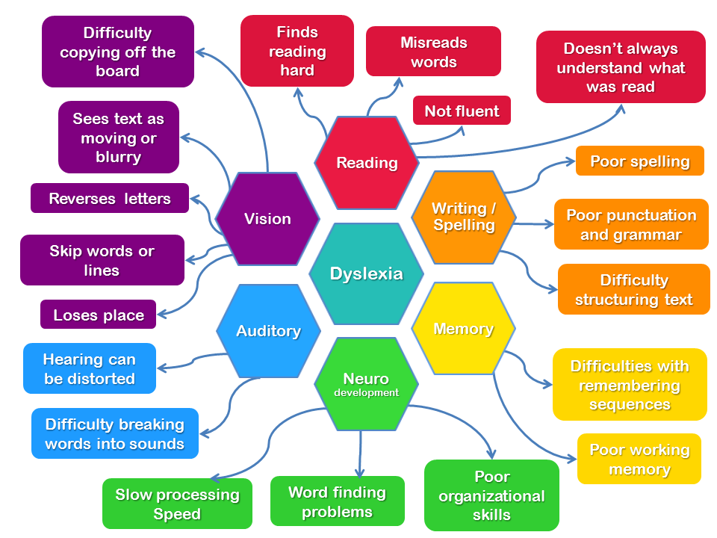

Slide 7
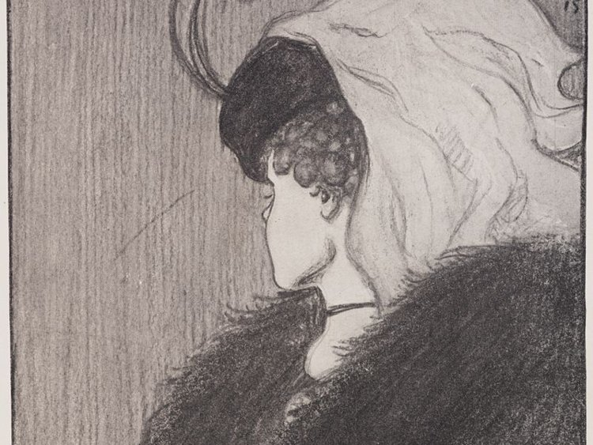
What do you see?
A young woman OR an older woman?

Slide 8

What do you see?
A vase OR two faces?

Slide 9
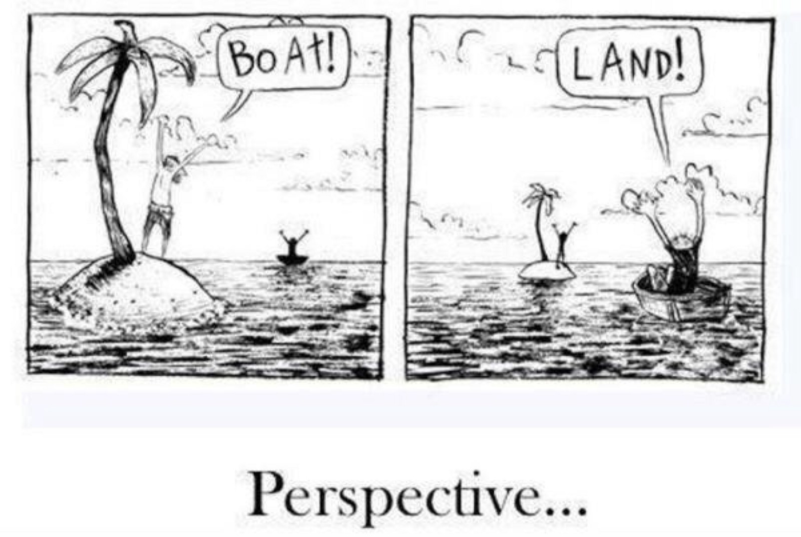
It’s all about…
…perspective!
Notes:
Remember - no two children are the same, so it is important that teachers and TAs take the time to find out as much as they can about how your child learns best.
That will involve talking to you – you are the expert on your child!

Slide 10

How might a child with additional needs feel?
That everybody else is better than me
Embarrassed
Anxious
Frustrated
Cross
Slow
Stupid

Slide 11

If a child is feeling low, what sorts of behaviours might you see?
Chew my pen or flick rubbers
Take it out on people at home
Get cross with everyone
Refuse to do anything
Just want to sit there and do nothing
Bite my nails
Get scared of doing anything
Shout out and misbehave

Slide 12


Improving self-esteem
It’s really important that schools, together with parents, support children to develop their resilience, confidence and self-esteem.

Slide 13

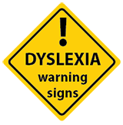
Areas of challenge that children
can encounter

Slide 14
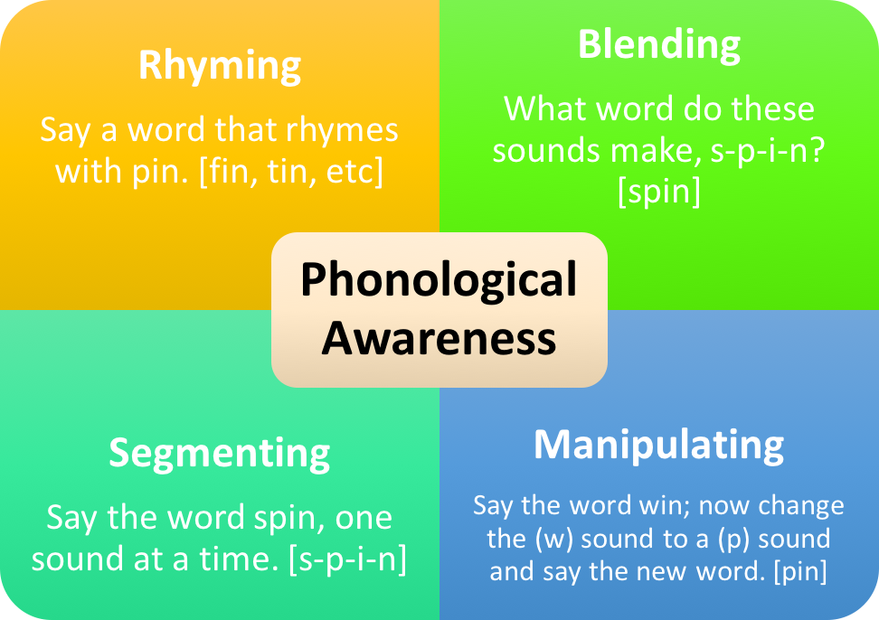
Difficulties with phonological awareness
Notes:
Harder for children with dyslexia to map sounds to symbols
May have difficulty with rhyme, alliteration, blending, segmentation
Reading, writing and spelling will be affected

Slide 15

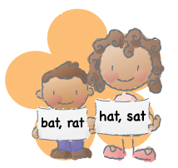
Phonological awareness
This is the ability to recognise and work with individual sounds (phonemes).
How do small children learn that words have meaning?
Notes:
Phonological awareness is regarded as the most important element of literacy acquisition.
NOT PHONICS!!
a method of teaching people to read by correlating sounds with symbols in an alphabetic writing system

Slide 16
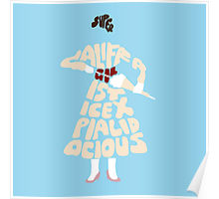
14 syllables
Supercalifragilisticexpialidocious
su/per/cal/i/frag/i/lis/tic/ex /pi/al/i/do/cious

Slide 17
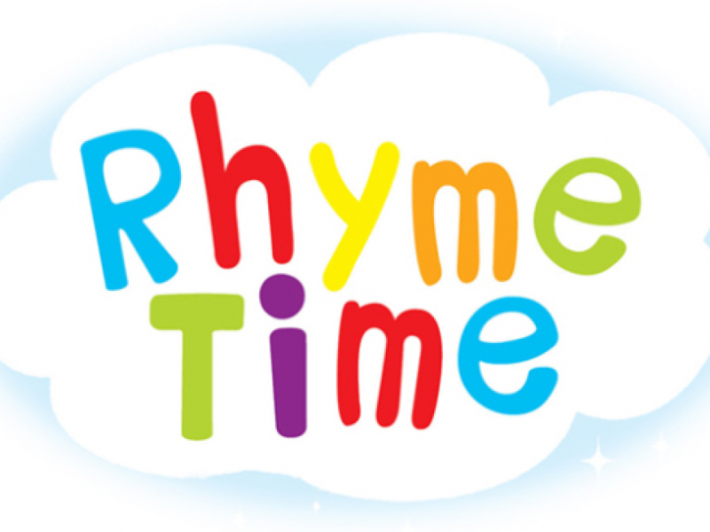
Games to support the development of phonological awareness
Rhyme
Pass a feely bag around
Take out an item
Once you’ve taken the item out, name it and generate a rhyming word. The word can be a real word or a ‘non-word’

Slide 18
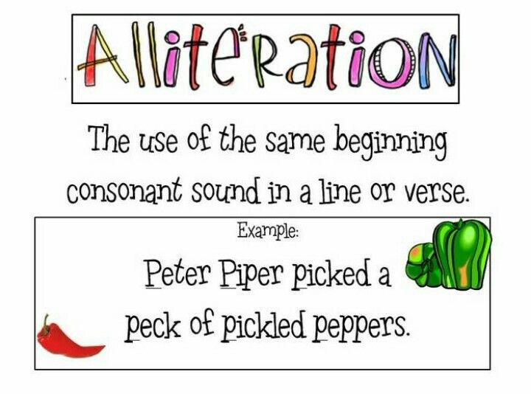
Games to support the development of phonological awareness
Alliteration
Work individually
Choose a letter from the board
On a sheet of paper, name as many words as possible starting with your letter
30 seconds – go!
Children use the first letter of their name to start with
You could act as a scribe for your child

Slide 19
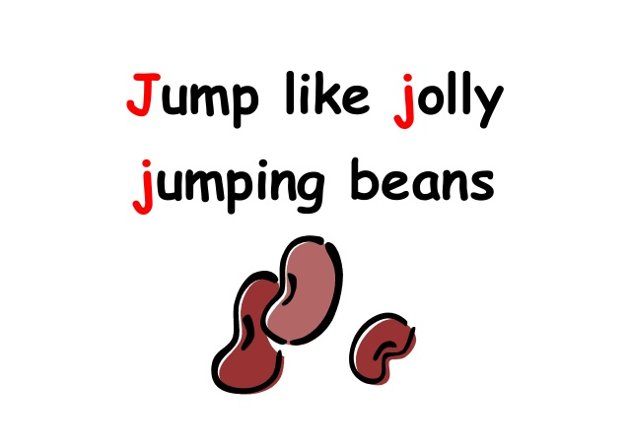
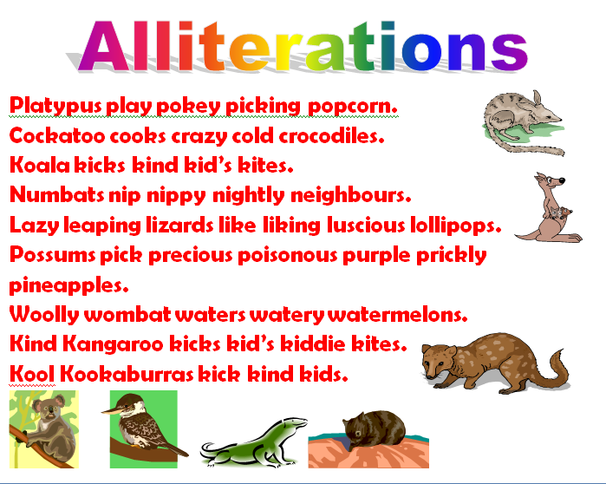
Games to support the development of phonological awareness
Alliteration
Work in pairs this time
Using your words from the first activity, make up some silly sentences using alliteration
Share a sentence with your group

Slide 20
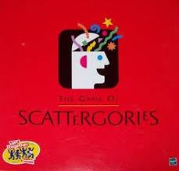
Scattergories
 | B | A | S
Country
Food
Vegetable
Animal
Book
Item in house
Song
City
Fruit
Drink

Slide 21
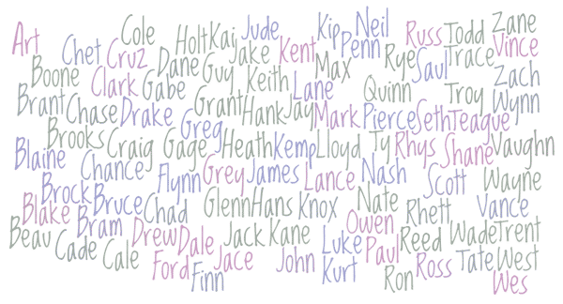
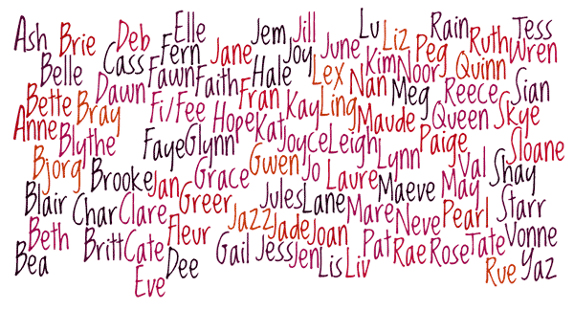
Games to support the development of phonological awareness
Syllable identification
Practise clapping your family’s names as you break them down into syllables (pets included!)

Slide 22
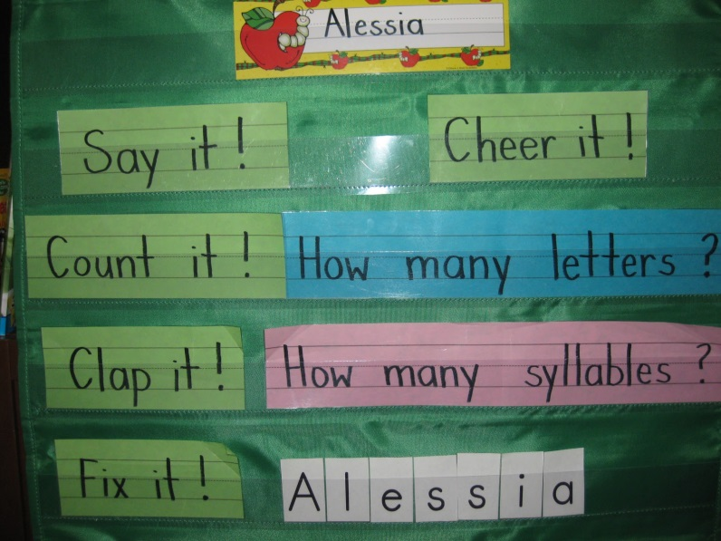
Games to support the development of phonological awareness
Syllable deletion
Keep the ‘number of syllables in your name’ theme
Only say the first syllable of your name now and clap the remaining syllables (if any)
E.g. ‘Gem/ma’ will now be ‘Gem/clap’

Slide 23
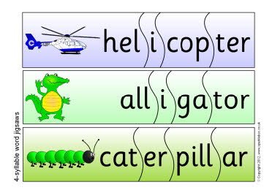

Games to support the development of phonological awareness
Segmenting syllables
Take a piece of A4 blank paper
Draw a picture of an object that has 2 or more syllables
Once everyone has finished, count down and launch your planes!
Collect someone else’s plane and share name of object, breaking name down into syllables

Slide 24
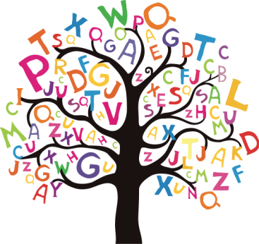
How do we spell?
We either:
know what a word looks like – sight words
or
we have to encode it – through grapheme/ phoneme correspondence
Good spellers are able to use both strategies
Notes:
Automaticity – ability to do things without thinking about it e.g. spelling top 100 hf words
Many learners with spld do not have automaticty and need to consciously think about every task
Lot more loading on brain power

Slide 25
Understanding and supporting spelling
What does spelling require?
Spelling requires recall
Reading requires recognition
Recall is harder than recognition

Slide 26
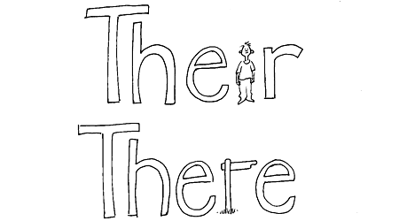
Practical ideas for learning spellings at home
create mnemonics for ‘tricky’ words
a mnemonic is a memory aid and can help children to remember the spelling of tricky words
mnemonics can be visual or written/auditory
only practise one spelling until it is secure
Written/auditory
Visual
Big
Elephants
Can
Add
Up
Sums
Easily

Slide 27
Practical ideas for learning spellings at home
Roll the die – if it lands on:
1. Think of a picture to represent the word.
2. Draw a mnemonic to help spell the word.
3. Spell out word using letter names.
4. Write word in air with finger.
5. Write word down on paper.
6. Close your eyes, imagine spelling the word in your head.
Spelling dice!
Notes:
Really quick activity to play at home with the weekly spellings!

Slide 28
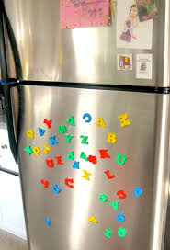
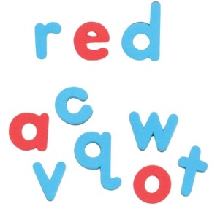
Practical ideas for learning spellings at home
display illustrated key word lists around the home (on walls, doors, fridges etc)
magnetic/wooden/plastic letters can beused
make sure that the letters are lower case
when spelling words with magnetic/plastic/wooden letters, try using a different colour for the vowels

Slide 29
Practical ideas for learning spellings at home
Highlighting common letter patterns in words. i.e retreat and defeat
Use a highlighter to visually show the difference. If using magnetic letters, try using a different colour for the letter patterns.
street | good
green | food
sleep | blood
see | flood
three | stool
tree | wood

Slide 30
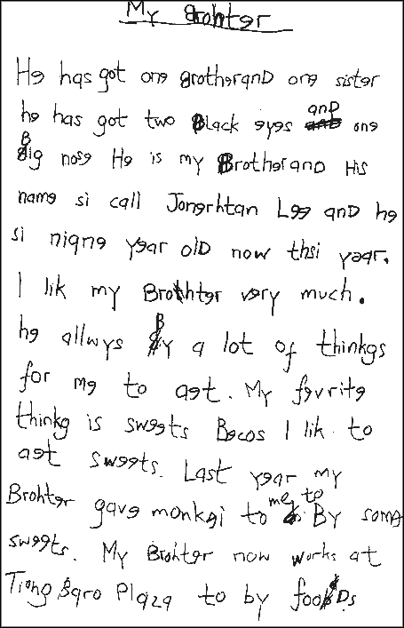

Children may have difficulty writing
30
Notes:
Link to automaticity e.g. spelling a word differently several times in a piece of writing
Printing rather than joining, reversal of letters, lots of crossing out, limited punctuation and grammar (e.g. no paragraphs), little phonological awareness, minimal vowels or wrong vowels – harder to hear than consonants (e.g. spell September SPTMBR)
He has got one brother and one sister. He has got two black eyes and one big nose. He is my brother and his name is called Jonathan Lee and he is nine years old now this year. I like my brother very much. He always buys a lot of things for me to eat. My favourite thing is sweets because I like to eat sweets.
Reversing letters and numbers. Cliché but can be true. B/d p/q writing in capitals, printing not joining.
Dyslexia means you might see 57 but remember it as 75 or write the answer to 6×7 as 24 instead of 42.
The output of the information becomes muddled. The numbers he uses are correct. They’re just written incorrectly.
Children who struggle with reversing numbers might have issues with visual processing. But it doesn’t necessarily mean that they will struggle with maths concepts or that they have trouble with maths.
Keep in mind that it’s common for young children who reverse numbers to reverse letters, too.
No quick solutions. But there are ways you can help to correct the issue over time.
In general, children who need help with this tend to respond best to a multisensory approach. They might trace numbers on sandpaper or write them in paint or shaving foam, for instance.
Repetition is key to success. It builds muscle memory. Might need to practice writing and identifying these numbers many, many times before he’s able to consistently form them the correct way. 66 days to become a habit. Precision teaching here!
That throws off their computation and results in wrong answers. Using a multisensory approach and practicing often can also help with this problem. Practice identifying and forming numbers at home. Find ways to involve multiple senses.
Reversal of numbers can be as common in a child’s work as reversing letters. Remember – just this one isolated trait does not automatically mean a child is dyslexic. We need the whole picture.
How would you mark this? Focus for next time? Positive comments? Constructive criticism?

Slide 31

Strategies to support writing tasks:
writing frame: storyboard, sequence board, story mountain/map etc.
mind-maps
multiple choice, true/false
scribe
flow charts
iPad ‘Notes’
talking tins/keyrings etc.

Slide 32
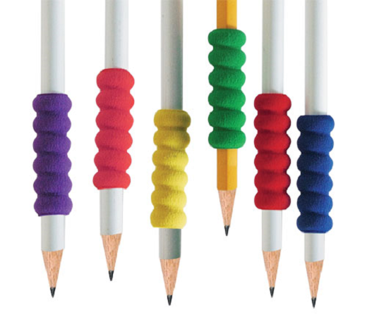
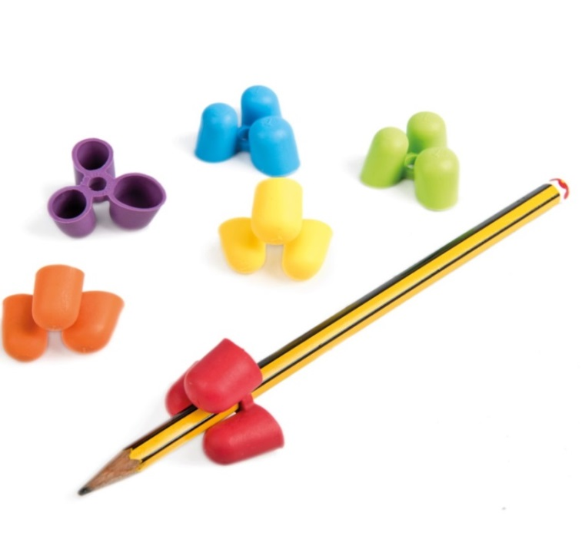
Strategies to support writing tasks:
Comfort Pencil Grip - gives added comfort and security to those who grasp the pencil too tightly (The Dyslexia Shop, £3.90 for 10)
Writing Claw Pencil Grip - designed to help improve the hold of a pencil by correcting the position of a child's fingers (TTS Group, from £7.99 for 6).

Slide 33
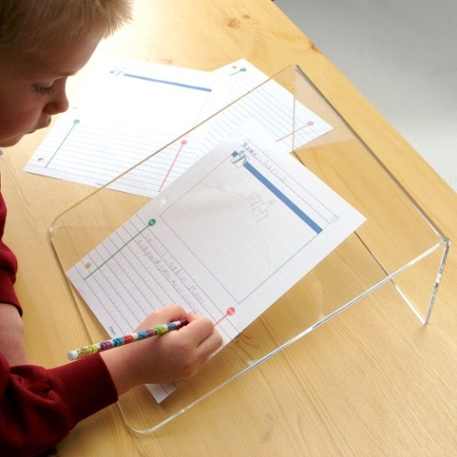
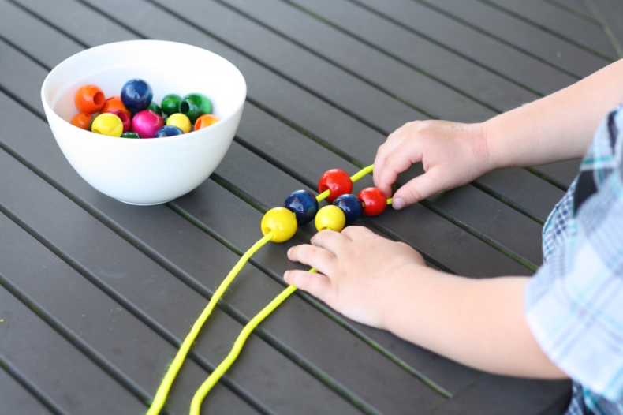
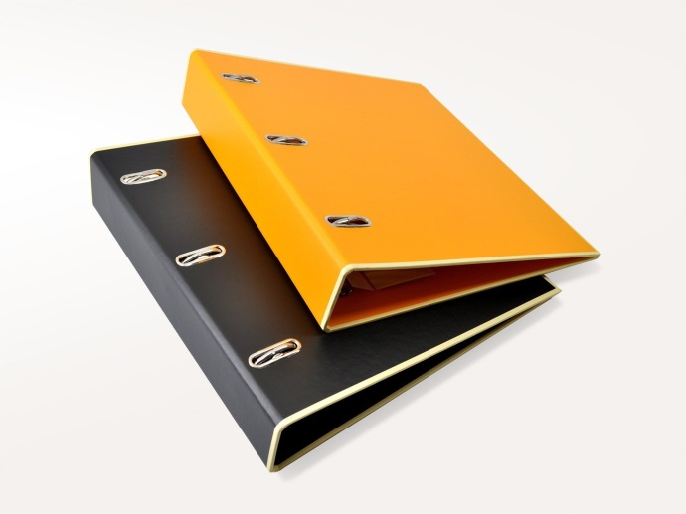
Strategies to support writing tasks:
Fine motor skills activities can improve the handwriting of some learners
Elevating a child’s book using a writing slope can help
Notes:
Writing on a slanted surface allows a child’s wrist to extend while the fingers flex and naturally fall into a better writing position. Instead of using a slant board, a child can use a three-inch three-ring binder turned sideways. A rubber band can keep papers from slipping off.

Slide 34
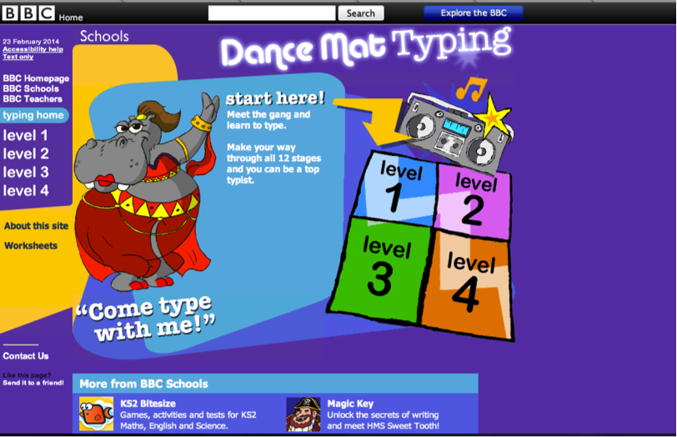
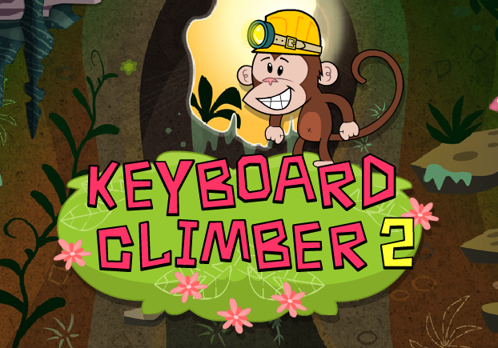
Strategies to support writing tasks:
https://www.bbc.co.uk/bitesize/topics/zf2f9j6/articles/z3c6tfr

Slide 35

Children may have difficulty reading
immediately forgets what has just been read
slower reading speed
misses out words or skips lines
may be able to read fluently but can’t answer questions about the text
http://www.independent.co.uk/extras/indybest/arts-books/best-kids-books-dyslexic-dyslexia-reluctant-readers-a7345621.html
Notes:
Barrington Stoke
Code X
Have you ever read a page, got to the bottom and realized you’ve just forgotten everything you read?
This happens all the time to people with dyslexia.
Words and their meanings don’t stick very well.
Reading becomes slow when you have to work out every word and expends so much mental energy on the process that no memory capacity is left to comprehend.
Dyslexia means they may have read a word then further down the page not recognize it again.
Children with dyslexia who have been taught phonics can often learn to say the individual sounds but not blend them together. They can’t hold the sequence of sounds in their head for long enough. They might just panic and guess wildly.
They have no visual memory for the word.
Their eyes can seem to jump over words, missing them out, skip out whole lines, sometimes they just skip part of a word.
May be able to read accurately but not have an understanding of the text.

Slide 36
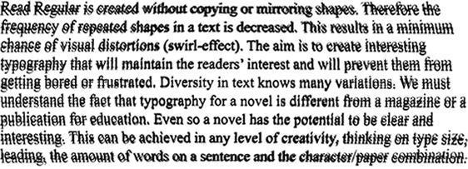
Visual Stress
Research has shown that 15 – 20% of people suffer visual stress to some extent
Also known as Irlen Syndrome or Scotopic Sensitivity Syndrome (SSS)

Slide 37


‘The letters are blurred or go out of focus.’
‘The letters move or look back to front.’
‘I get a headache when I read.’
‘The words and/or letters split or appear double.’
‘I find it easier to read large, widely spaced print, than small and crowded.’
Important to realise that children may not realise that this is a difficulty and may think it is the same for everyone – especially younger children

Slide 38

Strategies used by schools for visual stress
space is left between lines
a sans serif font such as Arial, Comic Sans, Verdana in size 12-14 is used
text will be divided into chunks (paragraphs, sentences, bullet points), paper may be enlarged from A4 to A3
pastel/buff paper and coloured backgrounds on interactive boards can be used

Slide 39
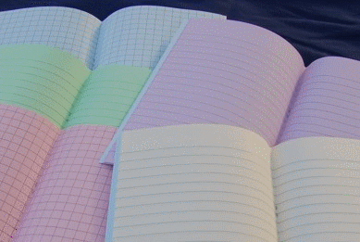
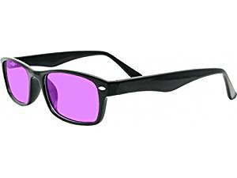

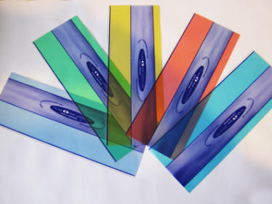

Resources to support visual stress
Notes:
Speak to parents!!!!!!!!!!!!

Slide 40
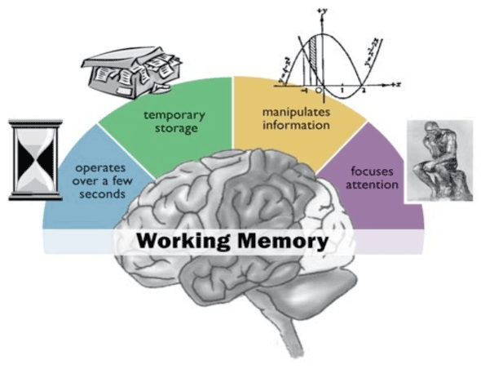
Children may have poor working memories
What is working memory?
holds, processes and manipulates information
limited capacity
develops later and more slowly than short-term memory
Notes:
responsible for the holding, processing and manipulation of information.
short-term memory buffer that allows for the manipulation of stored information, while short-term memory is only involved in the short-term storage of information and does not entail the manipulation or organization of material held in memory.
Working memory also develops later and at a slower pace than short-term memory.
Average adult can hold about 7 items in working memory
Link to backward digit span in DST
Tends to be weaker in children with ADHD

Slide 41
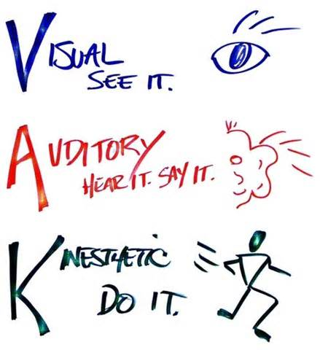
Strategies to support children with a poor working memory
Multisensory teaching is visual, auditory and kinaesthetic (what we feel) all at the same time. This helps memory and learning
Using multisensory techniques allows links to made between the visual, auditory and kinaesthetic pathways
I see what you mean.
That sounds good to me.
Most children (and adults!) have a preferred way to learn.
That feels right to me.
Notes:
We’ve talked a lot about multi-sensory learning. A lot of buzz a few years ago about VAK – visual, auditory, kinaesthetic. Most learners have a preferred method but we try to encourage a range of learning styles.
Most dyslexic pupils tend to be either visual or kinaesthetic learners.
Auditory – 30% of population
Visual – 65% of population
Kinaesthetic – 5% of population
Each of us has a natural preference for the way in which we prefer to receive, process and impart information. This is largely genetically determined but is also susceptible to development, particularly when we are young (whilst our neural pathways are still being established). There are various ways in which preferred processing modes become apparent and some simple ways in which we can enhance the effectiveness of our communication once we are aware of them. One way to detect a person's preferred processing mode is to watch their eye movements, particularly when they are thinking or answering a question.
Where do you think you fit? Do you fit into one area?
Most teachers intuitively believe there must be something inclusive about learning styles; some learners like to work fast, some take their time. Some ask questions, others reflect but experience also warns us, that if taken too literally, for example as a tool to ‘scientifically’ match learners to their preferred way of thinking, we run the risk of stifling the learning environment and are just as likely to entrap, as empower, the learners.
‘Good’ teachers know their learners; they stimulate a learning environment where it is safe to speak out, yet challenging enough to encourage new ways to look at, think about, and use maths.
So how can we achieve this ‘good’ practice without falling the trap of expecting, or being prescribed, a ‘perfect’ recipe for teaching, or for learning, mathematics?
Three methods (or modes) of receiving and processing information. This is often referred to as the VAK model. Each of us has a natural preference for the way in which we prefer to receive, process and impart information. This is largely genetically determined but is also susceptible to development, particularly when we are young (whilst our neural pathways are still being established). There are various ways in which preferred processing modes become apparent and some simple ways in which we can enhance the effectiveness of our communication once we are aware of them.

Slide 42


Strategies to support children with a poor working memory
Multi-sensory - auditory
discussions
peer explaining
reading aloud
internal dialogue
audio recordings
mnemonics
Multi-sensory – kinaesthetic
moving around
touching/handling things
using all of the senses
practical tasks
role play

Slide 43
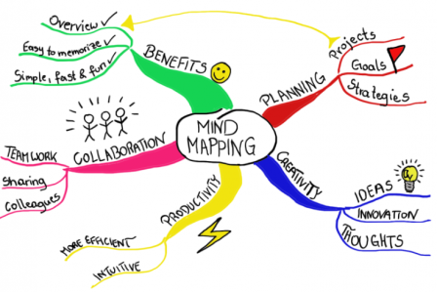
Strategies to support children with a poor working memory
Mind-mapping:
good way to organise ideas
interesting way to plan writing tasks
suits the do-ers
suits the thinkers
suits the hands-on children

Slide 44
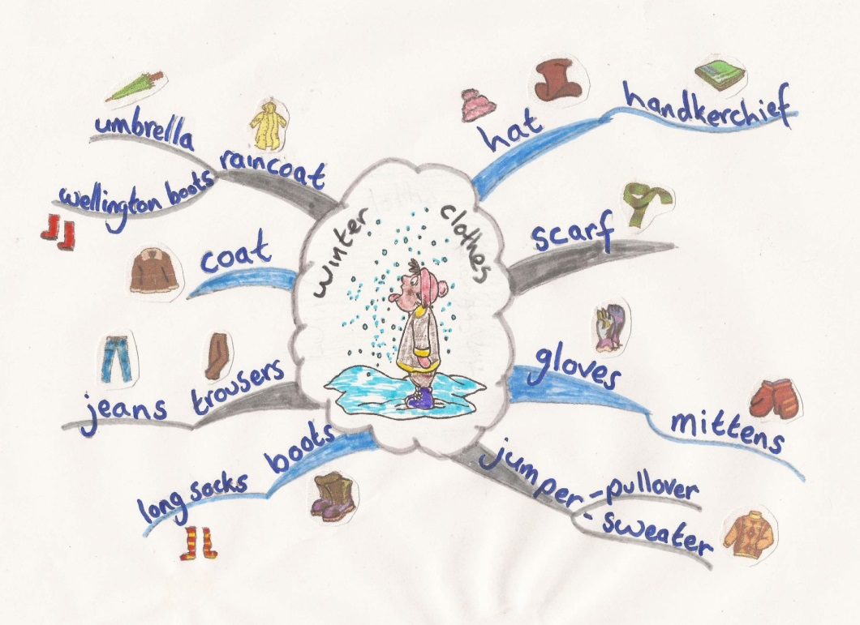
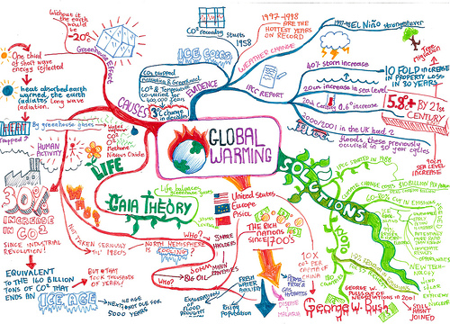
Notes:
Can be used from key stage 1 upwards
Post it notes could be used to record the topics before adding to a large piece of paper and drawing on the arrows
Start by using a whiteboard so that mistakes are easily erased

Slide 45


Further mind-mapping resources:
Tony Buzan – www.tonybuzan.com, many books available e.g. Mind Maps for Kids
apps for mind mapping (iPads) – Popplet, SimpleMind, MindMeister, iMindMap
http://www.bbc.co.uk/keyskills/extra/module4/1.shtml - beginner’s guide to mind mapping
Notes:
A tip to help learners to organise their ideas initially - enter the post-it note!
Instead of writing their ideas directly onto the paper, encourage learners to write their ideas onto sticky post-it notes which could then be arranged and re-arranged before being transferred onto the resultant map. This particular strategy is especially useful because it appeals to the full spectrum of learning styles.
Visual learners can see the shape of the map as it takes shape
Auditory learners can discuss where items should be placed
Kinaesthetic learners can manipulate the data
Allows for spontaneity and reflection. Learners like it, particularly if they are working in groups, because they can get “stuck in” straight away.
Even the review phase is “hands on” and allows for some students to re-organise more complicated sections of the map while others are making a start on illustrating more straightforward sections.
The process as a whole generates plenty of discussion, encouraging students to consider not only what should be included on the map but where it should appear.

Slide 46
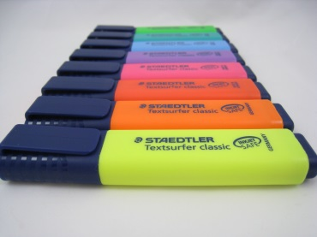
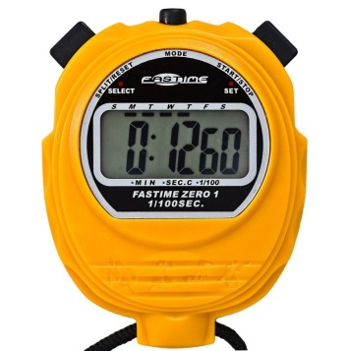


Building confidence at home – creating independence
Whiteboards/pens
Magnetic/wooden letters
Word lists/mats
Pens/pencils/pencil grips
Blank mnemonic cards (playing cards)
Clear acetates and pens
Post it notes
Highlighters
Stop watch
Overlays/reading rulers
Alphabet lines/key vocabulary books
Notes:
Try introducing a Literacy chest or box – these are the sorts of things they could contain.
Post-its for organising thoughts
Highlighters for key facts and figures.
Stopwatch for timing pieces of work/recall

