Slide 1
Be safe be seen
A presentation by Tyler Shepperd

Slide 2
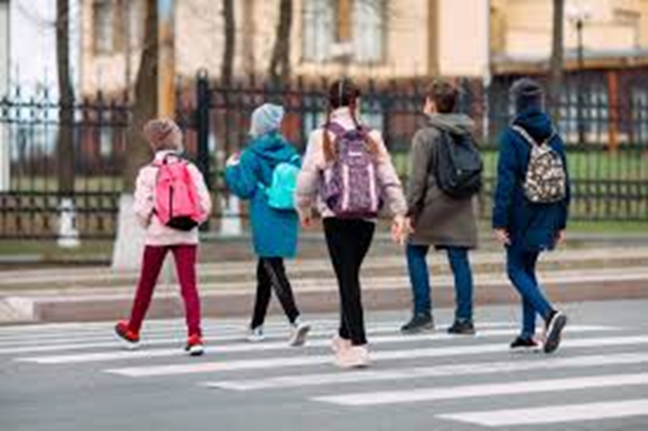
How to cross the road
First off all you need to look left and right , Secondly you need to listen for 5 seconds , finally look again and cross.

Slide 3
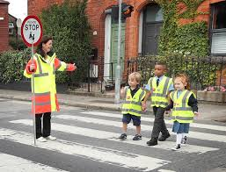
How to be safe
First we will talk about during day time and what to wear during this time you want to wear bright floral clothes so your easy to see. At night you to wear hi-vis and always follow the crossing rules.

Slide 4
Tips for the road
When you cross the road try to bring an adult with you for extra safety.
Never cross at or near a junction because you cant see the cars coming down the road.
In misty conditions always were hi-vis or don’t Cross at all.
Never cross with out looking even on a calm road.
Never run across the road to run to your mates.
Don’t push your friends into the road.
Always look for a crossing before crossing.
Always pay attention to the road.

